Slide 1
OPTIMIZING HIGH-PERFORMANCE DATA PROCESSING FOR LARGE-SCALE WEB CRAWLERS
Presented by: Group 3

Slide 2







Group Members
Muhammad Daniel Hakim Bin Syahrulnizam
Wong Khai Shian Nicholas
Nur Aleysha Qurratu’aini Binti Mat Salleh
A22EC0241
Nicole Lim Tze Yee
A22EC0207
A22EC0292
A22EC0123

Slide 3

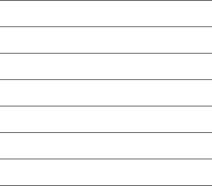
Slide Contents
1.0 Introduction
2.0 System Design & Architecture
3.0 Data Collection
4.0 Data Processing
5.0 Optimization Techniques
6.0 Performance Evaluation
7.0 Challenges and Limitations
8.0 Conclusion and Future Work

Slide 4



LARANA, INC.
Home
About
Contact
1.0 Introduction
This project uses Utusan Malaysia, a well-established Malaysian news platform, as the data source. The goal is to extract key information from news articles, including:
Title
Publication Date
Category (e.g., Nasional, Ekonomi, Sukan)
Article URL
Objectives
Develop a web crawler to extract at least 100,000 structured records.
Apply high-performance techniques (multithreading, multiprocessing, async requests) for faster crawling.
Clean, transform, and store data in a structured format.
Evaluate system performance using metrics like execution time, CPU/memory usage, and throughput.

Slide 5

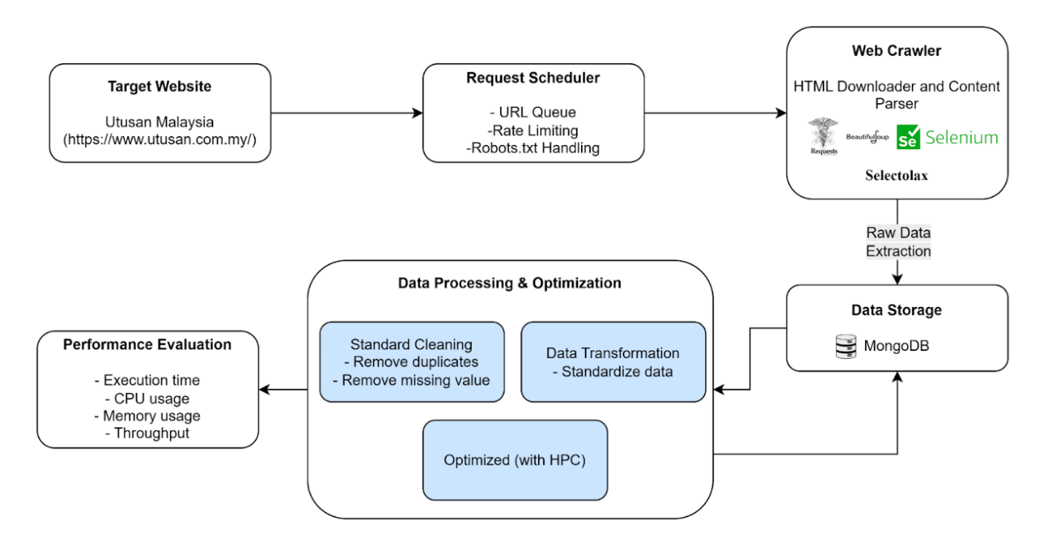

LARANA, INC.
Home
About
Contact
2.0 System Design Architecture
Figure 2.1: System Architecture

Slide 6



LARANA, INC.
Home
About
Contact
3.0 Data Collection
Data Fields
Article Title
PublicaArtiction Date
Article Category
Article URL
Numbers of Records Collected
Crawler 1 : 28544
Crawler 2 : 48847
Crawler 3 : 42450
Crawler 4 : 41854
Total : 161695

Slide 7



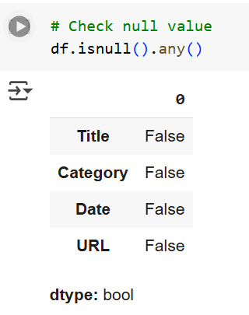
4.1 Cleaning Methods
This section outlines the complete data preparation pipeline. It includes cleaning, transforming, and structuring the raw crawled data to ensure it is accurate, consistent, and ready for analysis. Multiple libraries were used to experiment with performance, and cleaned datasets were stored in both CSV and MongoDB formats.
Handling Null Values
Removing Duplicate Records
To ensure the dataset’s quality, we first checked for missing values using df.isnull().any(). The result showed no missing values in the original dataset. However, to be cautious and focus only on essential fields, we explicitly dropped rows with nulls in the 'Title', 'Category', 'Date', or 'URL' columns using: df2 = df2[['Title', 'Category', 'Date', 'URL']].dropna(). This step ensures that only complete records are used in later analysis, preventing errors and bias from incomplete data.
To avoid repeated articles, we cleaned and deduplicated the 'URL' field.
We first stripped whitespace from each URL using: df2['URL'] = df2['URL'].apply(lambda x: str(x).strip() if isinstance(x, str) else x). Then, we dropped duplicate entries based on the 'URL' column:
df2.drop_duplicates(subset='URL', keep='first', inplace=True). This step ensures that each article appears only once in the dataset, which is critical for producing accurate statistics and avoiding skewed results.

Slide 8

4.2 Transforming
Standardizing the 'Category' Column
Removing Rows with 'No Date'
Aligning the Date Format
To improve consistency across the dataset, the values in the 'Category' column were standardized. We converted each category value to a string and capitalized only the first letter using: df2['Category'] = df2['Category'].astype(str).str.capitalize() This avoids inconsistencies due to different capitalizations (e.g., “EKONOMI”, “ekonomi”, and “Ekonomi” all become “Ekonomi”), helping in reliable grouping and filtering during analysis.
Some records contained 'No Date' values which are not useful for time-based analysis.
We cleaned these rows using the following line:
df2 = df2[~df2['Date'].astype(str).str.strip().str.lower().eq('no date')]. This line ensures that all remaining records have valid, meaningful date values, which is crucial for analyzing trends over time or sorting by publication date.
The original date values were in Malay with inconsistent formatting. We addressed this by creating a dictionary (month_map) to convert Malay month names to numbers and defined a function to reformat them into a standard format (YYYY-MM-DD HH:MM:SS).
df2['Date'] = df2['Date'].apply(convert_date)
This transformation ensures all date entries follow the same format, making it easier to perform chronological sorting, filtering, and time-series analysis.

Slide 9
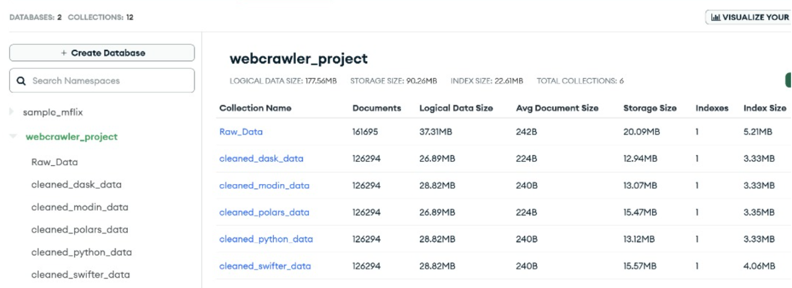

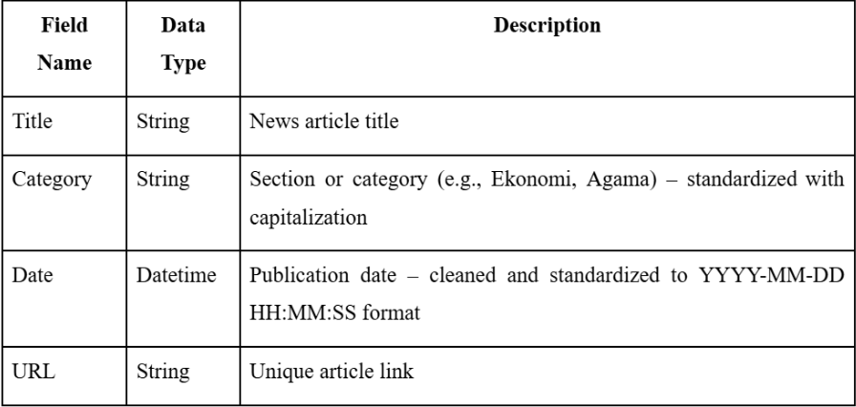


Cleaned datasets from different libraries (Pure Python, Swifter, Modin, Dask, Polars) were uploaded into separate MongoDB collections within the webcrawler_project database.
This organized storage makes it easy to evaluate the performance of each cleaning method and reuse the data for future analysis.
4.3 Data Structure
After cleaning, the datasets were saved in two formats: CSV files and MongoDB collections.
Each cleaned dataset contains four fields — 'Title', 'Category', 'Date', and 'URL' — with consistent formatting.
This structure supports efficient querying and makes it easy to compare results across different cleaning libraries.

Slide 10
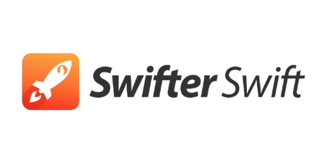



5.1 Optimization Methods Used
Swifter
ABCDEFGHIJKLMNOPQRSTUVWXYZ abcdefghijklmnopqrstuvwxyz 1234567890! @#$%^&*()
Modin
Speeds up Pandas by using all CPU cores
Requires minimal code changes
Ideal for large datasets with faster parallel data processing
This section outlines the primary optimization methods utilized. These techniques aim to leverage parallel processing and distributed computing to expedite computations and handle large datasets more effectively.
Dask
Scales Pandas workflows by dividing data into partitions.
Enables parallel processing with lazy evaluation using .compute().
Ideal for large datasets and memory-efficient cleaning tasks.
Polars
Polars uses lazy evaluation, which allows it to build a query plan first then optimize the entire pipeline before execution.

Slide 11


5.2 Code Overview of Techniques Applied
This section presents an overview of the data cleaning code, highlighting the differences between the unoptimized version using standard Pandas and the optimized version leveraging high-performance computing techniques.

Slide 12
5.2.1 SWIFTER
Pandas .apply() is convenient but slow for large datasets where it processes data row by row, sequentially. Swifter solves this by automatically applying parallelization or vectorization, depending on the task’s complexity. You get faster execution without needing to rewrite your logic or switch frameworks.
PARALLEL PROCESSING (MULTICORE EXECUTION)
PERFORMANCE BENCHMARKING (EXECUTION TIME & THROUGHPUT)
RESOURCE MONITORING (CPU & MEMORY USAGE)
CONVERT ‘DATE’ COLUMN EFFICIENTLY
TRACK CPU AND MEMORY USED DURING SWIFTER EXECUTION
In Pandas, .apply() runs row-by-row using a single CPU core which slow for large datasets. .swifter.apply() parallelizes this operation across multiple CPU cores, dramatically reducing runtime while keeping the same function logic.
MEASURE HOW FAST DATA CLEANING RUNS
Using psutil, you can monitor
CPU usage (see if multicore is being utilized) and memory usage (ensure large datasets don’t consume too much RAM)
Confirms Swifter’s efficiency is not only fast but also resource-aware.
Swifter optimization is tracked using time.time() before and after execution. This allows you to calculate execution time throughput. This shows the real speedup achieved with Swifter vs. traditional Pandas.

Slide 13

5.2.2 Modin
Modin offers parallelized Pandas operations using all CPU cores
Requires minimal code changes — same API as Pandas
Ideal for speeding up data cleaning and processing of large datasets
Modin uses Ray to distribute data and tasks:
import os
os.environ["MODIN_ENGINE"] = "ray"
Ray is a distributed computing framework
Enables Modin to maximize system resource usage
Results in faster data processing and analysis
Original Pandas:
import pandas as pd
With Modin (no major change needed):
import modin.pandas as pd

Slide 14
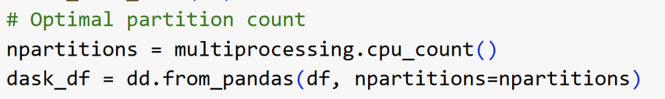
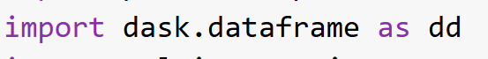
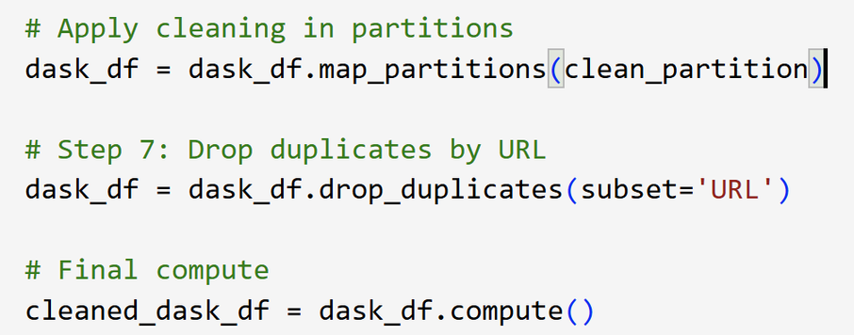
5.2.3 Dask
Optimal Partition Count
Imports the Dask library
The number of partitions is dynamically set based on the available CPU cores to ensure optimal parallelism.
Enables each partition to be processed concurrently, significantly reducing execution time.
The dataset is converted into a Dask dataFrame, which splits the data into multiple smaller partitions and processes them in parallel.
Apply map_partitions
“map_partitions” applied the cleaning logic independently to each partition, which preserves the lazy evaluation model.
operations like string parsing and datetime conversion are only performed when compute() is explicitly called.

Slide 15


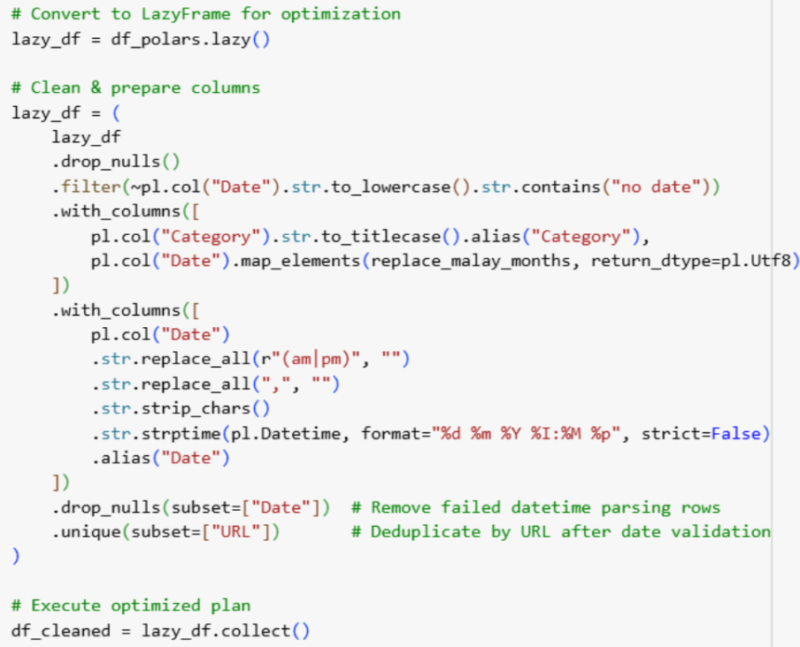
5.2.4 Polars
Converts the standard DataFrame to a LazyFrame, allowing deferred execution for better performance (similar to Spark).
Drop rows with null values.
Title-cases the Category (e.g., "nasional" → "Nasional").
Applies a custom function replace_malay_months to the Date column to standardize Malay month names (e.g., "Mei" → "May").
Ensures unique articles based on the URL.

Slide 16

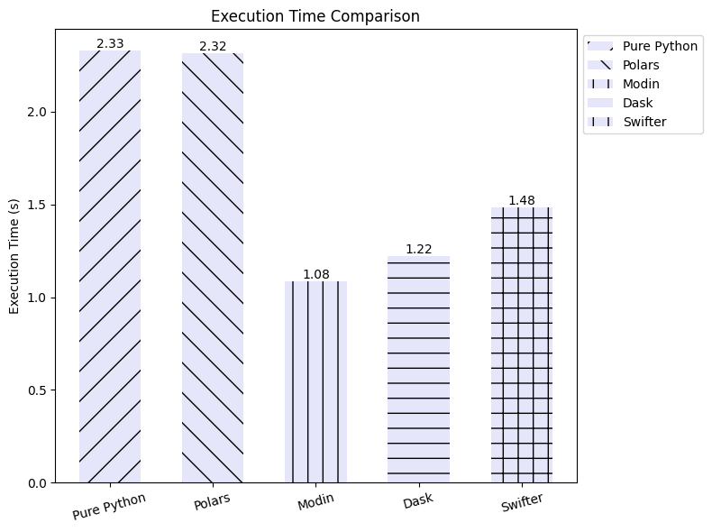
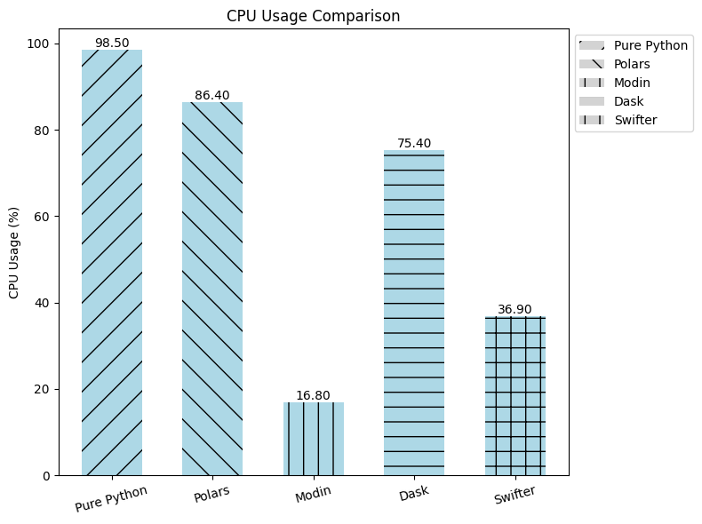
6.0 Performance Evaluation
Comparison of Execution Time between Libraries
Comparison of CPU Usage between Libraries

Slide 17
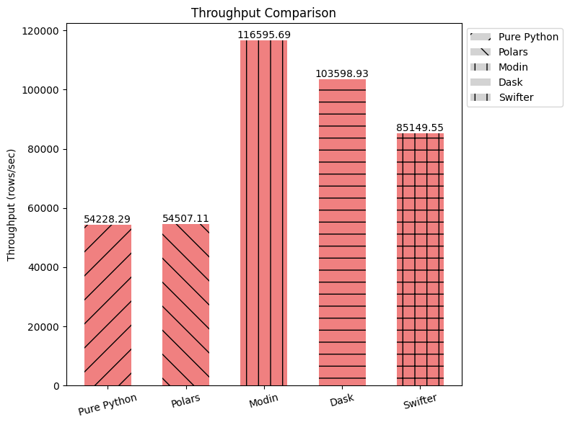
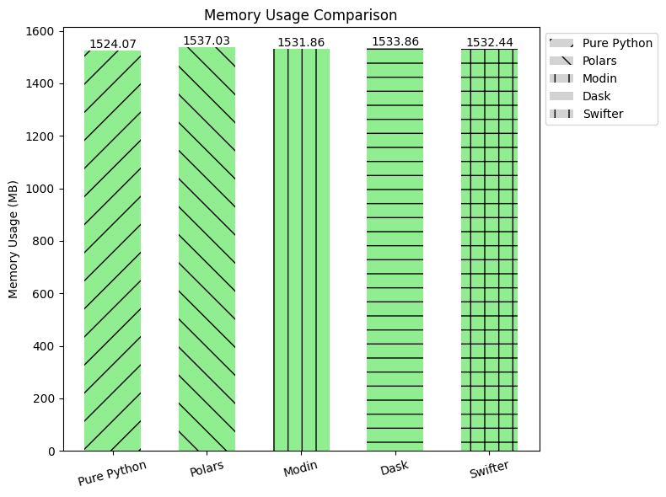
6.0 Performance Evaluation
Comparison of Throughput between Libraries
Comparison of Memory Usage between Libraries

Slide 18



7.0 Challenges and Limitations
Our initial websites:
Limited crawlable content
mostly e-commerce
very little structural variation
Access limits
Pagination issues
Long data extraction time
Target Website Changes

Slide 19
7.0 Challenges and Limitations
Limitation of Beautiful Soup
Insufficient for dynamic content
Solution: Integrated Selenium to handle dynamic pages
Complexity of Scrapy Framework
Web Crawler Libraries
Too complex & dependency-heavy for Google Colab
Chose modular tools: Requests, BeautifulSoup, Selenium, Selectolax

Slide 20


8.0 Conclusion
Summary of Findings
Developed scalable crawler targeting >100,000 news records from Utusan Malaysia
Multithreading reduced crawl time significantly
HPC libraries benchmarked:
Modin & Dask: Faster Pandas ops with minimal code change
Swifter: Speedups for row-wise cleaning
Polars: Major gains for columnar and query-like ops

Slide 21

8.0 Conclusion
Future Work
Distributed Crawling: Implement Scrapy Cluster or Kafka for large-scale parallel crawling
Fault Tolerance: Add smarter retry logic & enhanced error logging
Incremental Crawling: Crawl only new or updated articles to keep dataset fresh
Cloud-Based Processing: Deploy PySpark/Dask on AWS, GCP for better scalability
Post-Crawling Analysis
NLP for trend analysis, sentiment shifts, topic clustering

Slide 22

Thank You

